Slide 1





Noida Institute of Engineering and Technology, Greater Noida
PREDICTIVE ANALYTICS
Unit: 2
MULTI LINEAR REGRESSION
Mr. Sovers Singh Bisht
Assistant Professor
DS-DEPT
NIET
B-Tech 5TH Sem
ONLINE & Offline (Sec A, B )

Slide 2

Noida Institute of Engineering and Technology, Greater Noida
Mr. Sovers Singh Bisht
Dep. HOD (Data Science)
B.Tech, M.Tech
PH.D (P) in CSE ..
Area of Expertise: Data Science, Big Data Analytics
& Cloud Computing.

Slide 3

Evaluation Scheme
PROGRAM ELECTIVES BUCKET
DS
 | Data Analytics | Full Stack Development | Mobility Management | CRM-RPA
Program Elective 1 | Predictive Analytics | Python Web Development with Django | Mobile Application Development | CRM Fundamentals
Program Elective 2 | Web Technologies | Design Patterns | Development in Swift Fundamentals | CRM Administration
Program Elective 3 | Programming for Data Analytics | Advanced Java Programming | Development in Swift Explorations and Data Collections | CRM Development
Program Elective 4 | Social Media Analytics | Web Development using MEAN Stack | Augmented Reality and Virtual Reality | Robotics Process Automation (RPA)
Program Elective 5 | Natural language Processing | Web Development using MERN Stack | Game Programming | Robotics Process Automation (RPA) Implementation

Slide 4
Evaluation Scheme
DATA ANALYTICS (AI/AIML)
SUBJECTS | CREDITS | ELECTIVE | SEMESTER
Predictive Analytics | 3 | I | 5th
Web Technologies | 3 | II | 5th
Programming for Data Analytics | 3 | III | 6th
Social Media Analytics | 3 | IV | 6th
Natural language Processing | 3 | V | 7th

Slide 5

Evaluation Scheme
B.Tech. (Data Analytics-DS)
Elective- I
5th SEMESTER
PREDICTIVE ANALYTICS
L T P | Credits
3 – 0 – 0 | 3

Slide 6
Course Contents / Syllabus
B. TECH. THIRD YEAR (ELECTIVE-I)
Course code |  |  | L T P | Credits
Course title |  | PREDICTIVE ANALYTICS | 3 0 0 | 3
Course objective:
To be able to solve complex problems that require discovering hidden patterns in the data and a deep understanding of intricate relationships between a large number of interdependent variables tasked with collecting, analyzing, and interpreting large amounts of data.
Pre-requisites: Basic concepts of Machine learning Algorithms
Course Contents / Syllabus
UNIT-I | LINEAR REGRESSION |  |  | 8 HOURS
Introduction to Predictive Analytics, Regression basics: Relationship between attributes using Covariance and Correlation, Relationship, between multiple variables: Regression (Linear, Multivariate) in prediction, Residual Analysis Identifying significant features, feature reduction using AIC, multi-collinearity, Non-normality and Hetero scedasticity, Hypothesis testing of Regression Model, Confidence intervals of Slope, R-square and goodness of fit, Influential Observations – Leverage.
UNIT-II | MULTIPLE LINEAR REGRESSION |  |  | 8 HOURS
Polynomial Regression, Regularization methods, Lasso, Ridge and Elastic nets, Categorical Variables in Regression.
UNIT-III | NON-LINEAR REGRESSION |  |  | 8 HOURS
Logit function and interpretation, Types of error measures (ROCR), Logistic Regression in classification.

Slide 7
Course Contents / Syllabus
UNIT-IV |  | FORECASTING MODELS |  |  | 8 HOURS
Trend analysis, Cyclical and Seasonal analysis, smoothing, Moving averages, Box-Jenkins, Holt-winters, Autocorrelation, ARIMA, Examples: Applications of Time Series in financial markets.
UNIT-V |  | FEATURE ENGINEERING |  |  | 8 HOURS
Data Science Vs. Machine Learning, Exploratory Data Analysis, Feature Encoding, Imputation Feature Scaling, Determining correlation, Feature selection, Feature extraction.
Course outcome: After completion of this course students will be able to
CO 1 | Apply specific statistical and regression analysis methods applicable to predictive analytics to identify new trends and patterns, uncover relationships, create forecasts, predict likelihoods, and test predictive hypotheses. | Apply specific statistical and regression analysis methods applicable to predictive analytics to identify new trends and patterns, uncover relationships, create forecasts, predict likelihoods, and test predictive hypotheses. |  |  |  | K1, K2
CO 2 | Learn how to select the appropriate method for predictive analysis, and how to build effective predictive models. | Learn how to select the appropriate method for predictive analysis, and how to build effective predictive models. |  |  |  | K2
CO 3 | Learn how to evaluate the soundness, appropriateness and validity of their models and how to interpret and report on results for a management audience. | K3
CO 4 | Apply predictive analytics approaches on diverse business cases and scenarios. | K4
CO 5 | Understand the process of formulating business objectives, data selection/collection, preparation and process to successfully design, build, evaluate and implement predictive models for a various business application. | K5, K6

Slide 8
External Links as per Syllabus
NPTEL/ Youtube/ Faculty Video Link:
Unit 1 | Predictive Analytics Tutorial | Linear Regression in Python | Logistic Regression | Great Learning - YouTube Multiple Regression Analysis: Hypothesis Tests - YouTube Mod-06 Lec-28 Goodness of Fit - YouTube
Unit 2 | Multiple Linear Regression Model - YouTube Regularization In Machine Learning | Regularization Example | Machine Learning Tutorial |Simplilearn - YouTube Implementing Ridge, Lasso and Elastic Net in Python from Scratch (Mathematics Explained!) - YouTube
Unit 3 | Non Linear Regression | Data Science | Econometrics - YouTube Machine Learning Tutorial Python - 8: Logistic Regression (Binary Classification) - YouTube
Unit 4 | Time Series Talk : ARIMA Model - YouTube Holt winters Model, Easiest Times series Model. Additive multiplicative trend and seasonality - YouTube Time Series Analysis in Python | Time Series Forecasting | Data Science with Python | Edureka - YouTube
Unit 5 | Data Science vs Machine Learning – What’s The Difference? | Data Science Course | Edureka - YouTube Exploratory Data Analysis (EDA) Using Python | Python Data Analysis | Python Training | Edureka - YouTube Feature Selection In Machine Learning | Feature Selection Techniques With Examples | Simplilearn - YouTube

Slide 9
Branch wise Applications
Predictive analytics is a branch of advanced analytics that makes predictions about future outcomes using historical data combined with statistical modeling, data mining techniques and machine learning. Companies employ predictive analytics to find patterns in this data to identify risks and opportunities.
Predictive analytics are used to determine customer responses or purchases, as well as promote cross-sell opportunities. Predictive models help businesses attract, retain and grow their most profitable customers. Improving operations. Many companies use predictive models to forecast inventory and manage resources.
Predictive analytics uses statistics and modeling techniques to determine future performance.
Industries and disciplines, such as insurance and marketing, use predictive techniques to make important decisions.
Predictive models help make weather forecasts, develop video games, translate voice-to-text messages, customer service decisions, and develop investment portfolios.
People often confuse predictive analytics with machine learning even though the two are different disciplines.
Types of predictive models include decision trees, regression, and neural networks.

Slide 10
Course Objective
The objective of this course is -
To be able to solve complex problems that require discovering hidden patterns in the data and a deep understanding of intricate relationships between a large number of interdependent variables tasked with collecting, analyzing, and interpreting large amounts of data.

Slide 11
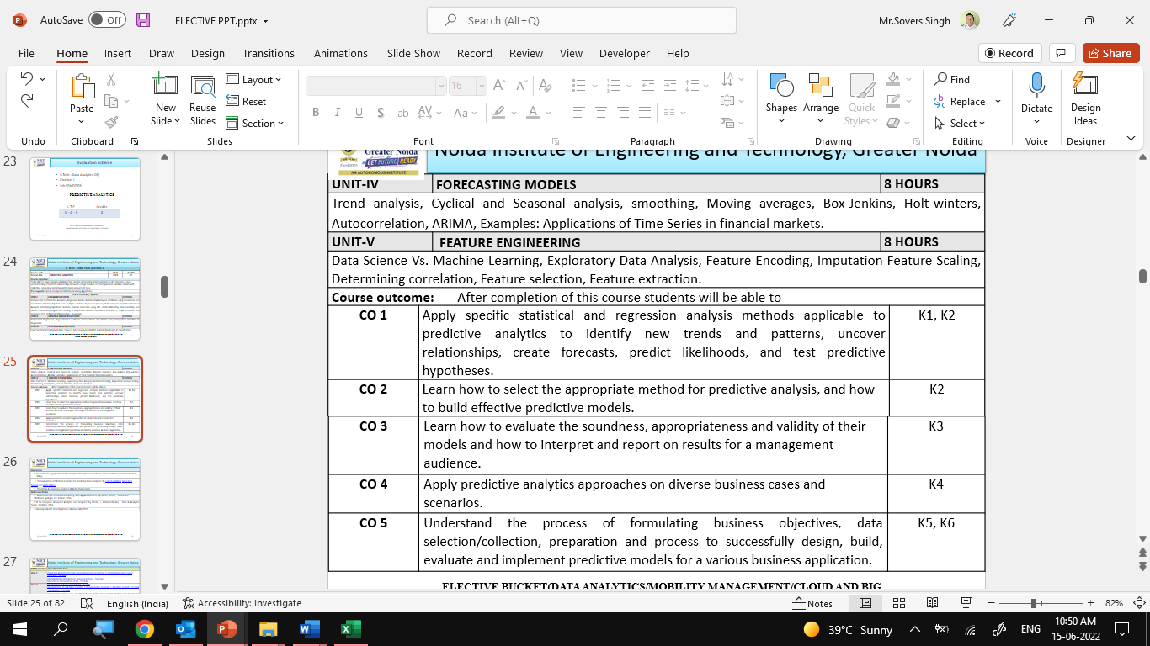

Course Outcomes

Slide 12
Program Outcomes
Engineering Graduates will be able to Understand:
1. Engineering knowledge
2. Problem analysis
3. Design/development of solutions
4. Conduct investigations of complex
5. Modern tool usage
6. The engineer and society
7. Environment and sustainability
8. Ethics
9. Individual and team work
10. Communication
11. Project management and finance
12. Life-long learning

Slide 13
CO-PO Mapping

Slide 14
Program Specific Outcomes (PSOs)
PSO’s
At the end of the program, the student will be able to-
PSO 1: Analyse, design and develop solutions by applying fundamental concepts of Data Science
PSO 2: Apply technical knowledge while using modern tools and technologies for solving complex problems.
PSO 3: Collaborate different fields of science and technology with right attitude, to work as an individual or as a team, demonstrating professional ethics for the well-being of society

Slide 15
COs and PSOs Mapping

Slide 16
Program Educational Objectives (PEOs)
PEO’s
The graduates of B.Tech Data Science program will-
PEO1: Solve real time complex problems and adapt to technological changes with the ability of lifelong learning.
PEO2: Work as data scientists ,entrepreneurs and bureaucrats for goodwill of the society and pursue higher education.
PEO3: Exhibit professional ethics and moral values with good leadership qualities and effective interpersonal skills

Slide 17
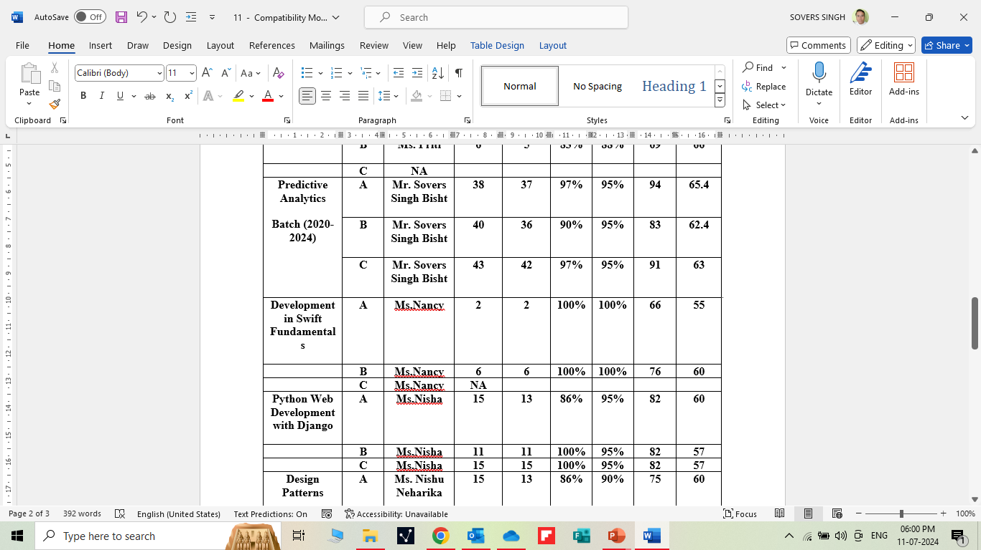
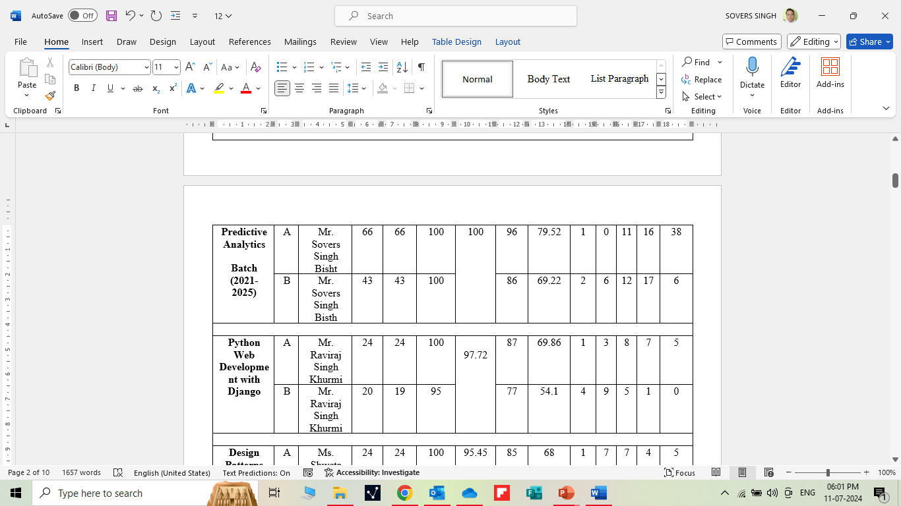
RESULT ANALYSIS

Slide 18
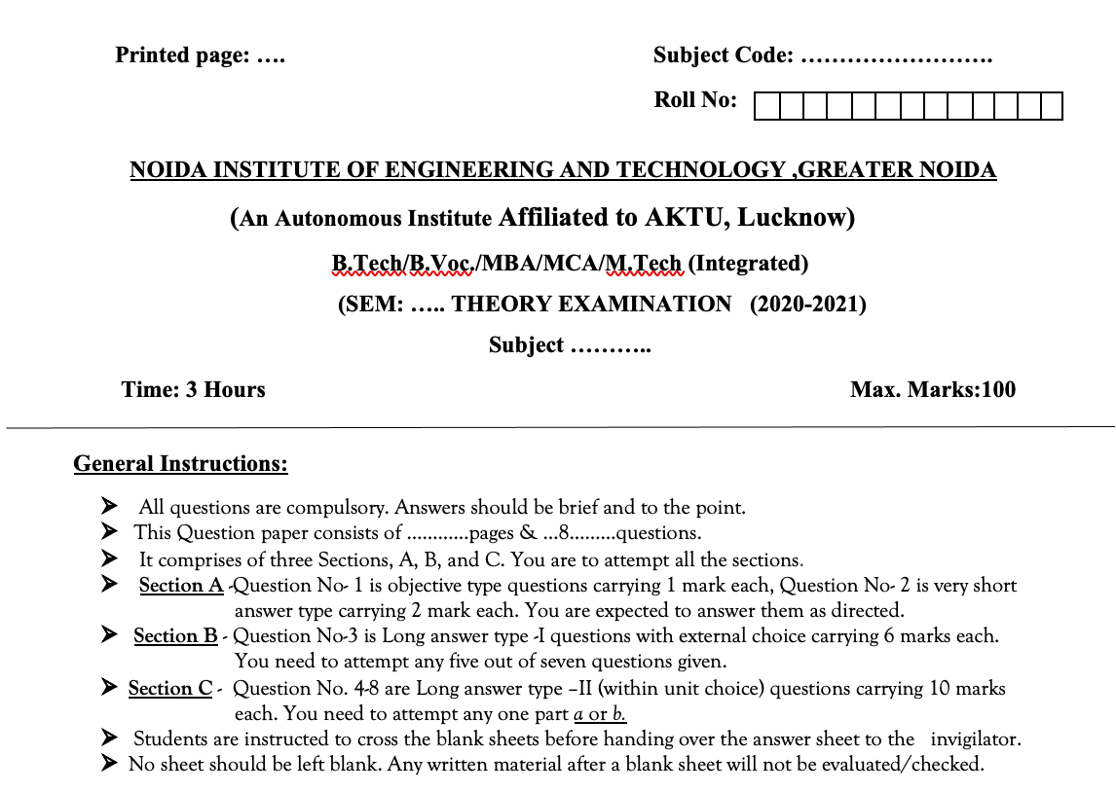
Question Paper Template

Slide 19
Question Paper Template
 |  | SECTION – A |  | CO
 | Attempt all parts- |  | [10×1=10]
 | 1-a. | Question- | (1)
 | 1-b. | Question- | (1)
 | 1-c. | Question- | (1)
 | 1-d. | Question- | (1)
 | 1-e. | Question- | (1)
 | 1-f. | Question- | (1)
 | 1-g. | Question- | (1)
 | 1-h. | Question- | (1)
 | 1-i. | Question- | (1)
 | 1-j. | Question- | (1)
2. | Attempt all parts- |  | [5×2=10] | CO
 | 2-a. | Question- | (2)
 | 2-b. | Question- | (2)
 | 2-c. | Question- | (2)
 | 2-d. | Question- | (2)
 | 2-e. | Question- | (2)
SECTION – B |  |  |  | CO
3. | Answer any five of the following- |  | [5×6=30]
 | 3-a. | Question- | (6)
 | 3-b. | Question- | (6)
 | 3-c. | Question- | (6)
 | 3-d. | Question- | (6)
 | 3-e. | Question- | (6)
 | 3-f. | Question- | (6)
 | 3-g. | Question- | (6)
SECTION – C |  |  |  | CO
4 | Answer any one of the following- |  | [5×10=50]
 | 4-a. | Question- | (10)
 | 4-b. | Question- | (10)
5. | Answer any one of the following-
 | 5-a. | Question- | (10)
 | 5-b. | Question- | (10)
6. | Answer any one of the following-
 | 6-a. | Question- | (10)
 | 6-b. | Question- | (10)
7. | Answer any one of the following-
 | 7-a. | Question- | (10)
 | 7-b. | Question- | (10)
8. | Answer any one of the following-
 | 8-a. | Question- | (10)
 | 8-b. | Question- | (10)

Slide 20
Prerequisite and Recap
Prerequisites:
Linux/ Windows operating system.
Knowledge of basic descriptive statistics and machine learning.
Java & R Studio.
MS Office 2019 and Above.
Programming Languages (Python)
Recap:
Discussion about Data Science Environments.

Slide 21
Brief Intro of Subject with video
Predictive analytics is a form of technology that makes predictions about certain unknowns in the future. It draws on a series of techniques to make these determinations, including artificial intelligence (AI), data mining, machine learning, modeling, and statistics.
For instance, data mining involves the analysis of large sets of data to detect patterns from it. Text analysis does the same, except for large blocks of text.
Predictive models are used for all kinds of applications, including:
Weather forecasts
Creating video games
Translating voice to text for mobile phone messaging
Customer service
Investment portfolio development
https://www.youtube.com/watch?v=4y6fUC56KPw
https://www.youtube.com/watch?v=JOArz7wggkQ

Slide 22
Contents
Linear Regression:
Polynomial Regression
Regularization methods
Lasso, Ridge and Elastic nets
Categorical Variables in Regression

Slide 23
Unit Objective
The objective of the Unit 2 is :
1.To provide an overview of an exciting growing field of data science.
2. To inculcate the preliminary knowledge of handling data , discuss various statistical techniques for handling data.
3. Predictive analytics is a decision-making tool in a variety of industries.
4. Multi Linear Regression is the model that is used the most in statistical analysis. Use it when you want to determine patterns in large sets of data and when there's a linear relationship between the inputs.

Slide 24
Polynomial Regression
Objective:
In this topic we learn about polynomial regression is a form of regression analysis in which the relationship between the independent variable x and the dependent variable y is modelled as an nth degree polynomial in x.
Recap:
Revision of basic statistical approaches.

Slide 25
Polynomial Regression
Multiple linear regression refers to a statistical technique that is used to predict the outcome of a variable based on the value of two or more variables. It is sometimes known simply as multiple regression, and it is an extension of linear regression. The variable that we want to predict is known as the dependent variable, while the variables we use to predict the value of the dependent variable are known as independent or explanatory variables.

Slide 26
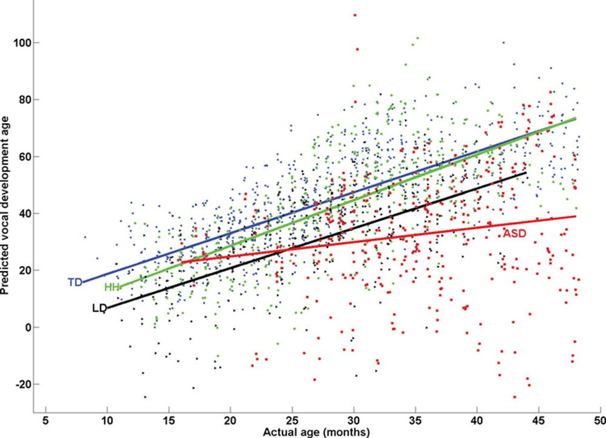
Polynomial Regression
Multiple linear regression model predictions for individual observations

Slide 27

Polynomial Regression
• Multiple linear regression refers to a statistical technique that uses two or more independent variables to predict the outcome of a dependent variable.
• The technique enables analysts to determine the variation of the model and the relative contribution of each independent variable in the total variance.
• Multiple regression can take two forms, i.e., linear regression and non-linear regression.
Multiple Linear Regression Formula
Where:
yi is the dependent or predicted variable

Slide 28
Polynomial Regression
β0 is the y-intercept, i.e., the value of y when both xi and x2 are 0.
β1 and β2 are the regression coefficients representing the change in y relative to a one-unit change in xi1 and xi2, respectively.
βp is the slope coefficient for each independent variable
ϵ is the model’s random error (residual) term.
Understanding Multiple Linear Regression
Simple linear regression enables statisticians to predict the value of one variable using the available information about another variable. Linear regression attempts to establish the relationship between the two variables along a straight line.
Multiple regression is a type of regression where the dependent variable shows a linear relationship with two or more independent variables. It can also be non-linear, where the dependent and independent variables do not follow a straight line.
Both linear and non-linear regression track a particular response using two or more variables graphically. However, non-linear regression is usually difficult to execute since it is created from assumptions derived from trial and error.

Slide 29
Polynomial Regression
1. Polynomial Regression
Polynomial Regression is a regression algorithm that models the relationship between a dependent(y) and independent variable(x) as nth degree polynomial. The Polynomial Regression equation is given below:
y= b0+b1x1+ b2x12+ b2x13+...... bnx1n
It is also called the special case of Multiple Linear Regression in ML. Because we add some polynomial terms to the Multiple Linear regression equation to convert it into Polynomial Regression.
It is a linear model with some modification in order to increase the accuracy.
The dataset used in Polynomial regression for training is of non-linear nature.
It makes use of a linear regression model to fit the complicated and non-linear functions and datasets.
Hence, "In Polynomial regression, the original features are converted into Polynomial features of required degree (2,3,..,n) and then modeled using a linear model."

Slide 30
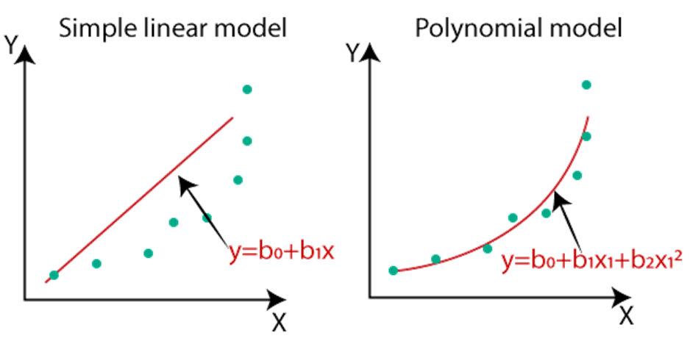
Polynomial Regression
Need for Polynomial Regression:
The need of Polynomial Regression in ML can be understood in the below points:
If we apply a linear model on a linear dataset, then it provides us a good result as we have seen in Simple Linear Regression, but if we apply the same model without any modification on a non-linear dataset, then it will produce a drastic output. Due to which loss function will increase, the error rate will be high, and accuracy will be decreased.
So for such cases, where data points are arranged in a non-linear fashion, we need the Polynomial Regression model. We can understand it in a better way using the below comparison diagram of the linear dataset and non-linear dataset.

Slide 31
Polynomial Regression
In the above image, we have taken a dataset which is arranged non-linearly. So if we try to cover it with a linear model, then we can clearly see that it hardly covers any data point. On the other hand, a curve is suitable to cover most of the data points, which is of the Polynomial model.
Hence, if the datasets are arranged in a non-linear fashion, then we should use the Polynomial Regression model instead of Simple Linear Regression.
Note: A Polynomial Regression algorithm is also called Polynomial Linear Regression because it does not depend on the variables, instead, it depends on the coefficients, which are arranged in a linear fashion.
Equation of the Polynomial Regression Model:
Simple Linear Regression equation: y = b0+b1x .........(a)
Multiple Linear Regression equation: y= b0+b1x+ b2x2+ b3x3+....+ bnxn .........(b)
Polynomial Regression equation: y= b0+b1x + b2x2+ b3x3+....+ bnxn ..........(c)

Slide 32
Contents
When we compare the above three equations, we can clearly see that all three equations are Polynomial equations but differ by the degree of variables. The Simple and Multiple Linear equations are also Polynomial equations with a single degree, and the Polynomial regression equation is Linear equation with the nth degree. So if we add a degree to our linear equations, then it will be converted into Polynomial Linear equations.

Slide 33
Regularization methods
Objective:
In this topic we learn about Regularization which is a technique used for tuning the function by adding an additional penalty term in the error function. The additional term controls the excessively fluctuating function such that the coefficients don't take extreme values.
Recap:
Revision of basic statistical approaches.

Slide 34
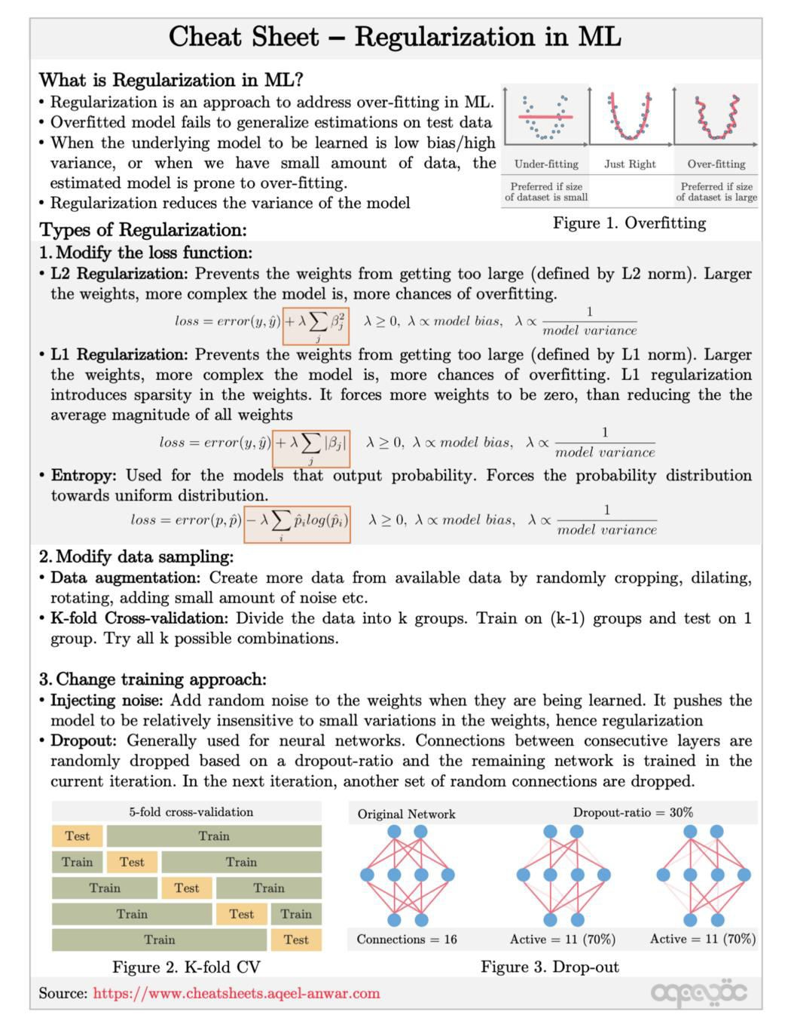
Contents
2. Regularization methods

Slide 35
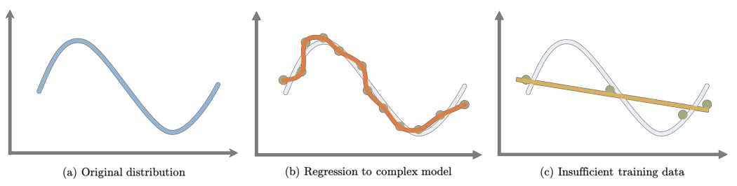
Contents
Why regularization?
Regularization is often used as a solution to the overfitting problem in Machine Learning. Common causes for overfitting are
When the model is complex enough that it starts modeling the noise in the training data.
When the training data is relatively small and is an insufficient representation of the underlying distribution that it is sampled from, the model fails to learn a generalizable mapping.
Overfitting in Machine Learning Regularization helps us overcome the issue of overfitting.

Slide 36
Contents
What is regularization?
Regularization consists of different techniques and methods used to address the issue of over- fitting by reducing the generalization error without affecting the training error much. Choosing overly complex models for the training data points can often lead to overfitting. On the other hand, a simpler model leads to underfitting the data. Hence choosing just the right amount of complexity in the model is critical. Since the complexity of the model can not be directly inferred from the available training data, it is often impossible to stumble upon the right model complexity for training.
This is where regularization comes into play making the complex model prone to overfitting.
Types of Regularization
Based on the approach used to overcome overfitting, we can classify the regularization techniques into three categories. Each regularization method is marked as a strong, medium, and weak based on how effective the approach is in addressing the issue of overfitting.

Slide 37
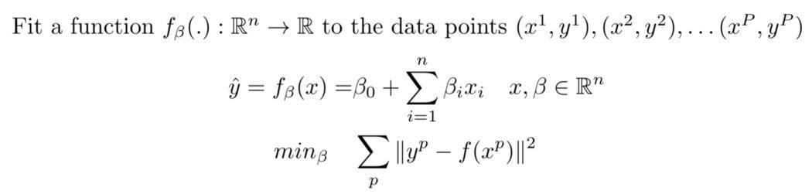
Contents
Modify loss function
In these regularization techniques, the loss function under which the model is optimized is modified to directly take into account the norm of the learned parameters or the output distribution. We have the following loss function based regularization techniques.
L2 Regularization (strong):
Consider the following linear regression problem with mean-squared loss.

Slide 38
Contents
In L2 regularization, we modify the loss to include the weighted L2 norm of the weights (beta) being optimized. This prevents the weights from getting too large and hence avoiding them to overfit.
Modified Loss with L2 regularization
The constant lambda (≥0) is used to control the compromise between overfitting and
underfitting. When lambda is high (low), the model tends to underfit (overfit).

Slide 39
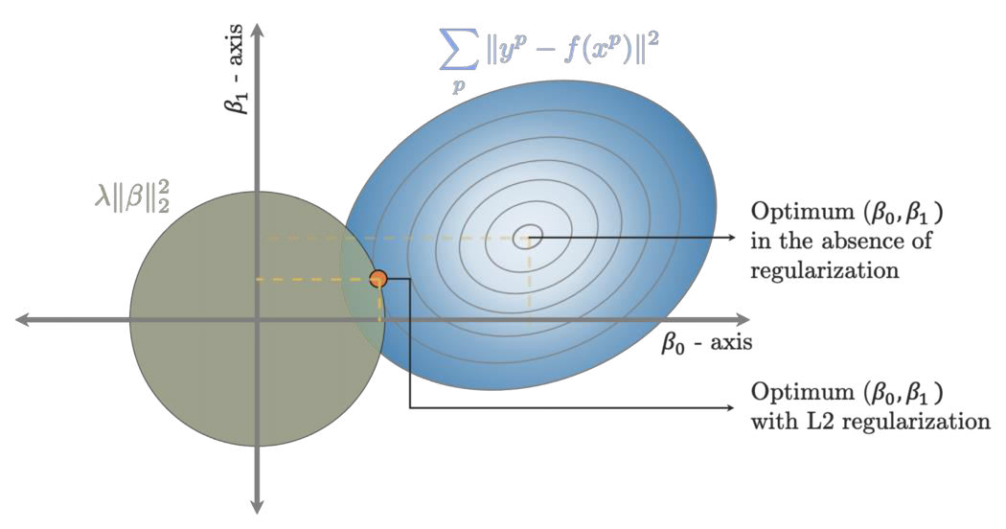
Contents
Let us consider the 2D case (n=2) where we can visualize the regression in the cartesian plane. The figure below plots the two parts of the loss function (MSE loss and L2 regularization) on the cartesian plane. The L2 regularize is plotted as a circle with a radius equal to lambda. The MSE loss has been plotted as a contour plot where the loss is equal on the ellipse. Solving weights for the L2 regularization loss shown above visually means finding the point with the minimum loss on the MSE contour (blue) that lies within the green ball. Increasing the value of lambda corresponds to an increase in the size of the green ball. When lambda is increased beyond a certain point, the green ball starts intersecting the actual un-regulated point of minima (In the figure shown as ‘Optimum beta_0, beta_1 in the absence of regularization’). This means that increasing lambda beyond this will not change our solution. For the model to address the over-fitting issue, the selected value of lambda must be between this value of lambda and 0.

Slide 40
Contents
Figure: Solving weights for the L2 regularization loss shown above visually means finding the point with the minimum loss on the MSE contour (blue) that lies within the L2 ball (green circle).
1.2. L1 Regularization (strong):
Instead of using the L2 norm of the weights in the loss function, in L1 regularization, the L1 norm (absolute values) of the weights are used. The modified loss becomes
Modified Loss with L1 regularization
Just like the L2 regularizer, the L1 regularizer finds the point with the minimum loss on the MSE contour plot that lies within the unit norm ball. The unit-norm ball for an L1 norm is a diamond with edges. Visually this can be seen in the figure below.

Slide 41
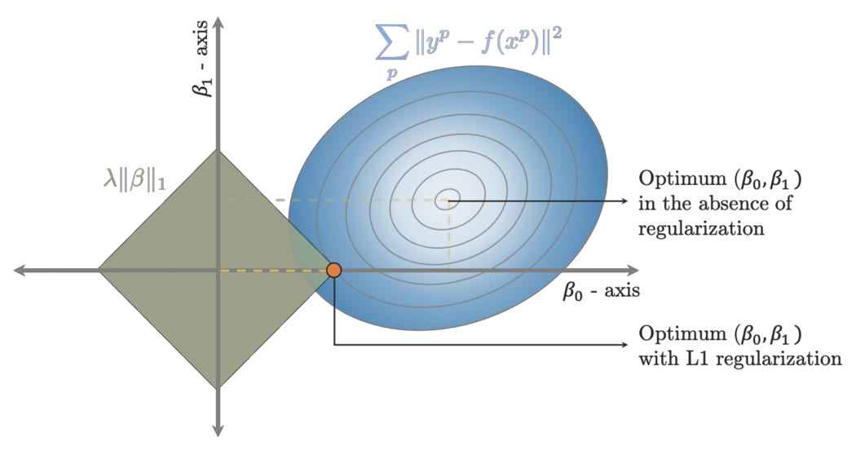
Contents
Figure: Solving weights for the L1 regularization loss shown above visually means finding the point with the minimum loss on the MSE contour (blue) that lies within the L1 ball (greed diamond).
The additional advantage of using an L1 regularizer over an L2 regularizer is that the L1 norm tends to induce sparsity in the weights. This means, with such a regularizer, the weights beta might have elements that are zero. The weights with the L2 regularizer can become really small, but they never actually go to zero.

Slide 42
Contents
Increasing the value of lambda increases the size of the diamond, reducing the actual MSE loss. This means that the weights start to fit the data points better and better which can lead to overfitting. Similar to the L2 regularizer, the un-regulated minima of the regression model is the same as the L1-regulated minima when lambda is really high.
1.3.Entropy Regularization (strong):
Entropy quantifies the probability distribution in terms of uncertainty in them. Greater the uncertainty in the distribution, the greater the entropy. A uniform distribution has an equal probability of all its event occurring, which means the amount of uncertainty is maximum and hence maximum entropy. On the other hand, an impulse-looking distribution means that if a random event is sampled from such a distribution, we know that it is always going to be the same one. Hence such an impulse-looking distribution has minimum entropy.
Entropy regularization is used when the output of the model is a probability distribution for example classification, policy gradient reinforcement learning, etc. Instead of directly using the norm of the weights in the loss term, the entropy regularizer includes the entropy of the output distribution scaled by lambda.

Slide 43
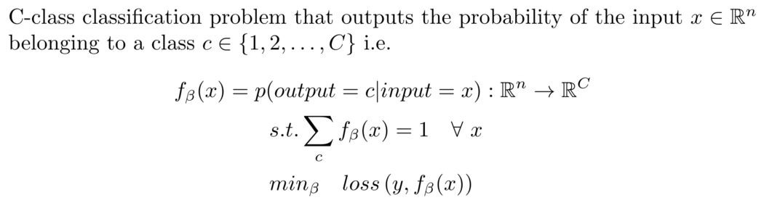
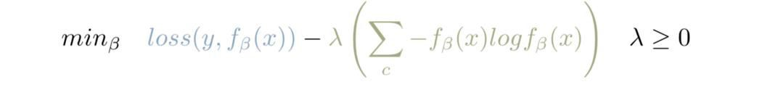
Contents
Consider the following classification problem.
The loss function is usually binary cross-entropy or hinge loss. In the case of Entropy regularization, the loss function is modified as follows
Modified Loss with Entropy regularization

Slide 44
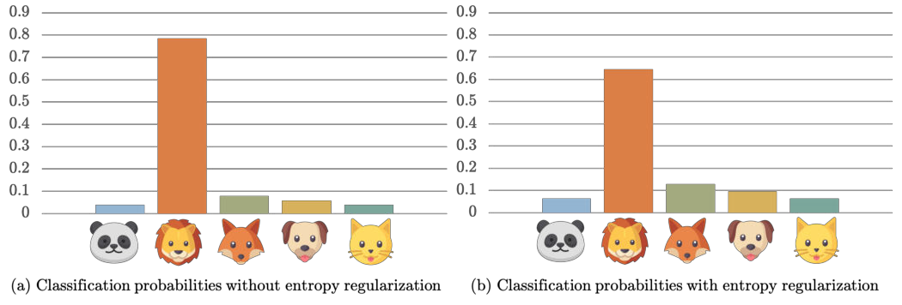
Contents
Since we want the output probabilities to have a certain degree of uncertainty in them, which means we want to increase the entropy. Since we are decreasing the loss, using entropy in the loss function, hence, needs to be multiplied by -1. The scaling constant lambda controls the regularization. The greater the value of lambda the more uniform the output distribution is.
Output distribution with entropy regularization

Slide 45
Contents
Modify sampling method
These methods are useful to overcome overfitting that arises due to the limited size of the dataset available. These regularization methods try to manipulate the available input to create a fair representation of the actual input distribution. Following are the two regularization methods that fall under this category
Data Augmentation (weak):
Data augmentation involves increasing the size of the available data set by augmenting them with more input created by random cropping, dilating, rotating, adding a small amount of noise, etc as shown in the example figure below. The idea is to artificially create more data in the hopes that the augmented dataset will be a better representation of the underlying hidden distribution. Since we are limited by the available dataset only, this method generally doesn’t work very well as a regularize.

Slide 46
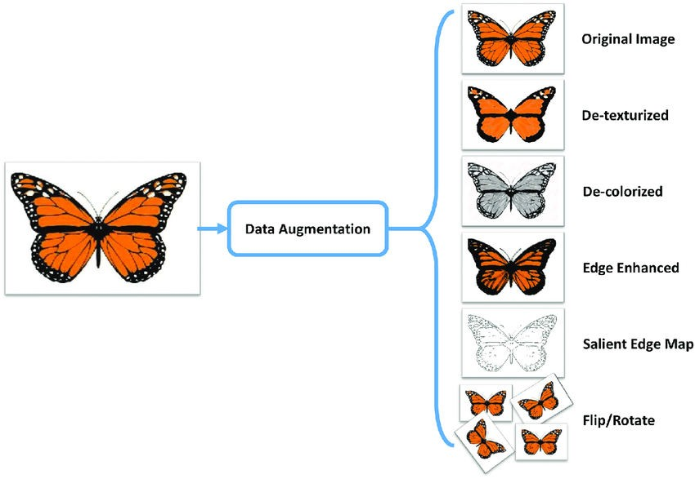
Contents

Slide 47
Contents
2.1.K-fold Cross-Validation (medium):
This method is used to create multiple trained networks and then select the one that gives the least generalization error. The model with the smallest generalization error will hopefully perform better than the other models on the unseen dataset sampled from the hidden distribution.
In K-fold Cross-validation, the available training dataset is divided into k non-overlapping subset and K models are trained. For each model, one of the k subsets is used for validation while the rest of the (k-1) subsets are used for training (as shown in the figure below). The model, once trained, is evaluated on the hold-out validation subset and the performance is recorded. Once all the K models are trained and the performance on the hold-out validation subset is recorded, the model with the best performance metric is selected as the final model.

Slide 48
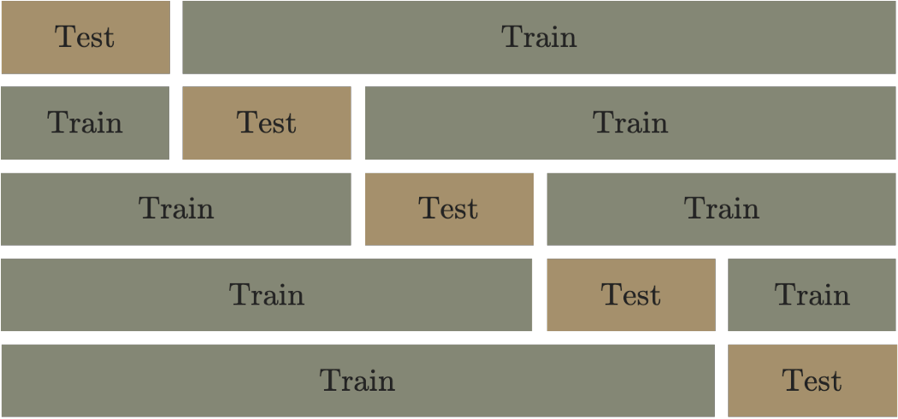
Contents
5-fold cross-validation — Image by Author

Slide 49
Contents
Modify training algorithm
Regularization can also be implemented by modifying the training algorithm in various ways. The two most commonly used methods are discussed below.
Dropout (strong)
Dropout is used when the training model is a neural network. A neural network consists of multiple hidden layers, where the output of one layer is used as input to the subsequent layer. The subsequent layer modifies the input through learnable parameters (usually by multiplying it by a matrix and adding a bias followed by an activation function). The input flows through the neural network layers until it reaches the final output layer, which is used for prediction.

Slide 50
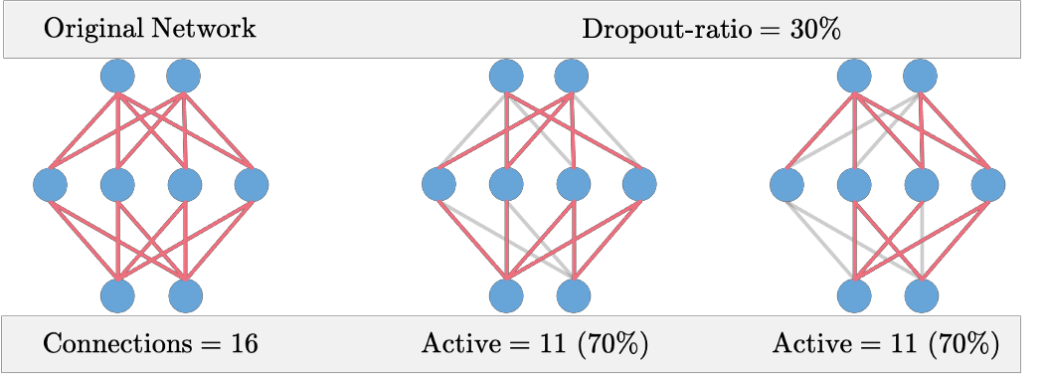
Contents
Each layer in the neural network consists of various nodes. Nodes from the previous layer are connected to nodes of the subsequent layer. In the dropout method, connections between the nodes of consecutive layers are randomly dropped based on a dropout-ratio (%age of the total connection dropped) and the remaining network is trained in the current iteration. In the next iteration, another set of random connections are dropped.

Slide 51
Contents
The dropout method ensures that the neural network learns a more robust set of features that perform equally well with random subsets of the node selected. By randomly dropping connections, the network is able to learn a better-generalized mapping from input to output hence reducing the over-fitting. The dropout ratio needs to be carefully selected and has a significant impact on the learned model. A good value of the dropout ratio is between 0.25 to 0.4.
3.2. Injecting noise (weak)
Similar to dropout, this method is usually used when the model being learned is a neural network. In this method, we tamper with the weights being learned through backpropagation in the efforts of making it more robust or insensitive to small variations. During training, a small amount of random noise is added to the updated weights which helps the model learn a more robust set of features. A robust set of features makes sure that the model doesn't overfit the training data. This method, however, doesn't work very well as a regularizer.

Slide 52
Lasso, Ridge and Elastic nets
Objective:
In this topic we learn about Lasso which will eliminate many features, and reduce overfitting in your linear model. Ridge will reduce the impact of features that are not important in predicting your y values. Elastic Net combines feature elimination from Lasso and feature coefficient reduction from the Ridge model to improve your model's predictions.
Recap:
Revision of basic statistical approaches.

Slide 53
Contents
3. Lasso
Lasso regression is a type of linear regression that uses shrinkage. Shrinkage is where data values are shrunk towards a central point, like the mean. The lasso procedure encourages simple, sparse models (i.e. models with fewer parameters). This particular type of regression is well-suited for models showing high levels of muticollinearity or when you want to automate certain parts of model selection, like variable selection/parameter elimination.
The acronym “LASSO” stands for Least Absolute Shrinkage and Selection Operator.
L1 Regularization
Lasso regression performs L1 regularization, which adds a penalty equal to the absolute value of the magnitude of coefficients. This type of regularization can result in sparse models with few coefficients; Some coefficients can become zero and eliminated from the model. Larger penalties result in coefficient values closer to zero, which is the ideal for producing simpler models. On the other hand, L2 regularization (e.g. Ridge regression) doesn’t result in elimination of coefficients or sparse models. This makes the Lasso far easier to interpret than the Ridge.

Slide 54

Contents
Performing the Regression
Lasso solutions are quadratic programming problems, which are best solved with software (like Matlab). The goal of the algorithm is to minimize:
Which is the same as minimizing the sum of squares with constraint Σ |Bj≤ s (Σ = summation notation). Some of the βs are shrunk to exactly zero, resulting in a regression model that’s easier to interpret.

Slide 55
Contents
A tuning parameter, λ controls the strength of the L1 penalty. λ is basically the amount of
shrinkage:
When λ = 0, no parameters are eliminated. The estimate is equal to the one found
with linear regression.
As λ increases, more and more coefficients are set to zero and eliminated (theoretically, when λ = ∞, all coefficients are eliminated).
As λ increases, bias increases.
As λ decreases, variance increases.
If an intercept is included in the model, it is usually left unchanged.
4. Ridge and Elastic nets
Ridge Regression
First, We Need To Understand What Bias And Variance Is?

Slide 56
Contents
Bias :
Bias Is The Simplifying Assumption Made By The Machine Learning Model To Make The Learning Process Easier. It Makes The Model Faster In Terms Of Learning From The Training Data But At The Same Time The Flexibility Of The Model Decreases If The Bias Is Significantly High.
A Model With High Bias Tends To Ignore The Complexity Between The Input And The Output Data And The Model Becomes Too Simple And Ultimately Results In The Underfitting Of The Data.
Variance:
Variance Occurs When The Model Performs Too Well On The Training Data But Its Efficiency Decreases Significantly When It Works On The Testing Data.

Slide 57
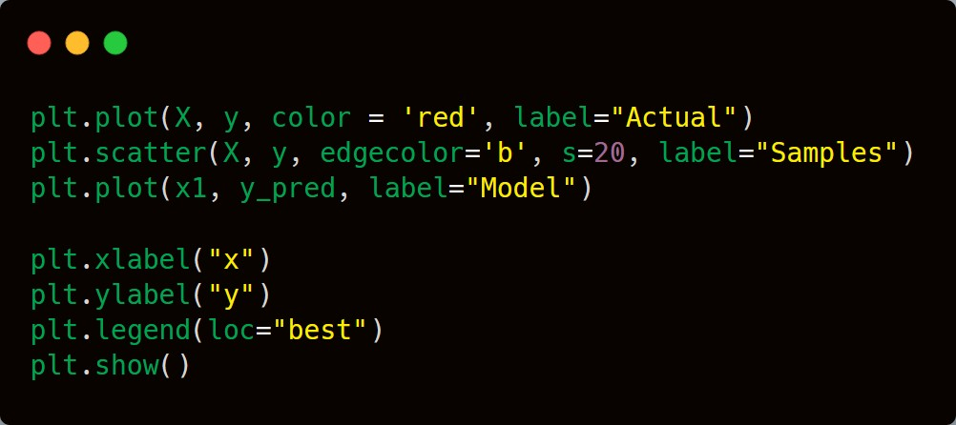
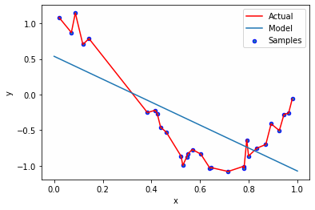
Contents
High Variance Means That The Model Learns From Training Data To That Extent That It Negatively Impacts The Performance Of The Model And Results In The Overfitting Of The Data.

Slide 58
Contents
Let’s Understand About The Main Topic Which Is What Ridge Regression Really Is?
Ridge Regression Is A Technique Which Is Used For Analyzing Multiple Regression Where The Data Suffers From Multicollinearity. The Problem Which Arises Due To Multicollinearity Is That The Basic Linear Regression Model (Least Square Estimates) Becomes Unbiased And The Variance Becomes So Large That The Predicted Values Are Far From The True Value.
The Advantage Of Using The Ridge Regression Is To Avoid Overfitting. It Works In The Same Way As The Linear Regression But It Just Adds An Extra Term (Α) Which Helps In The Reduction Of Overfitting. The Goal Of Any Machine Learning Model Is To Generalize The Pattern Which It Needs To Be Predicted; I.E. The Model Should Work Best On Both Training As Well As Test Data. Overfitting Occurs When The Trained Model Performs Well On The Training Data And Performs Poorly On The Testing Dataset.

Slide 59
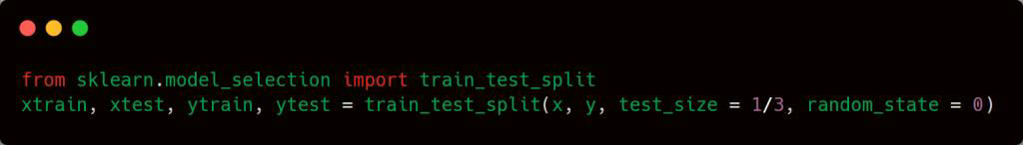
Contents
Let’s Take An Example, Suppose We Have A Dataset Having Salary Of Employees Based On The Years Of Working Experience They Have. This Data Is Just For The Sake Of Understanding, But Obviously In The Real World The Dataset Will Be Having Thousands And Thousands Of Rows And Columns.
YEARS OF EXPERIENCE | SALARY
1.1 | 39343
1.3 | 46205
1.5 | 37731
2 | 43525
To Make The Model Understand The Relationship Between The Input And The Output Data, We First Split The Dataset Into Training Set And Test Set.
The Code For Splitting The Data Is Given Below.

Slide 60
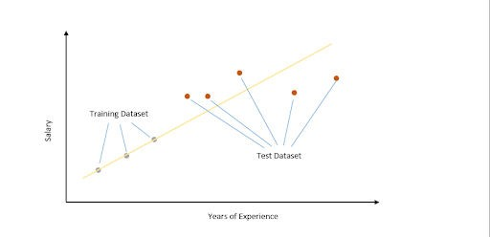
Contents
We Plotted The Data On The Graph And The Least Sum Of Squares (Classic Linear Regression Model) Is Applied To Obtain The Best Fit Line. Since The Line Passes Through The Training Dataset Points, The Sum Of Squared Residuals Is Zero.

Slide 61
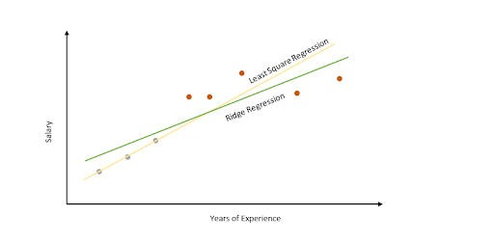
Contents
However, For The Testing Dataset, The Sum Of Residual Is Large So The Line Has A High Variance. Variance Means That There Is A Difference In Fit (Or Variability) Between The Training Dataset And The Testing Dataset.

Slide 62
Contents
Ridge Regression Works By Increasing The Bias To Improve Variance. This Works By Changing The Slope Of The Line. The Model Performance Might Be Little Poor On The Training Set But It Will Perform Consistently Well On Both The Training And Testing Dataset. Slope Has Been Reduced With Ridge Regression Penalty(Α) And Therefore The Model Becomes Less Sensitive To Change In The Independent Variable (Here It Is “Years Of Experience” In Our Example).
Least Square Regression
Min(Sum Of Squared Residuals)
Ridge Regression
Min(Sum Of Squared Residuals +𝞪*Slope2 )
Characteristics Of The Penalized Term (𝞪)
As Alpha Increases, The Slope Of The Regression Line Is Reduced And Becomes More Horizontal.

Slide 63
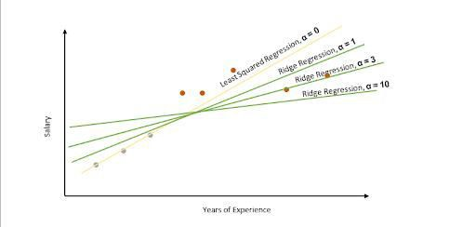
Contents
As Alpha Increases, The Model Becomes Less Sensitive To The Variation Of The Independent Variable (Here It Is “Years Of Experience” In Our Example).

Slide 64
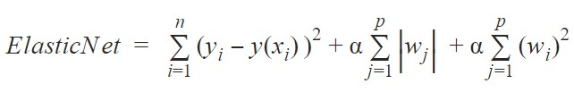
Contents
With This We Have Come To The End Of This Article. I Hope That You Get A Better Understanding Of Ridge Regression. Try To Implement It In Your Future Machine Learning Models And See How It Improves The Performance Of The Same Model Which Previously Suffered From The Problem Of Overfitting.
ELASTIC-NET REGRESSION
We Can Choose Ridge And Lasso Regression When We Have Enough Information About The Features But It Is Difficult To Choose One When The Data Has Too Many Features And Variables. In Such Cases, We Use Elastic-Net Regression Which Is Good At Estimating Correlations Between Features. The Penalty Function Of Elastic Net Regression Is A Combination Of Both L1 And L2 Penalties From Lasso And Ridge Regression Respectively. In Other Words, It Combines The Power Of Both Ridge And Lasso Regression. The Cost Function For Elastic-Net Regression Is Given Below

Slide 65
Contents
The Elastic Net Regression Has The Basic Least-Squares Followed By Lasso And Ridge Penalties With Their Respective Alpha Parameters 1and 2. The Most Optimum Combination Of Alpha Parameters Can Be Determined Using Cross-Validation.
Lasso vs Ridge vs Elastic Net
Bias:
Biases are the underlying assumptions that are made by data to simplify the target function. Bias does help us generalize the data better and make the model less sensitive to single data points. It also decreases the training time because of the decrease in complexity of target function High bias suggest that there is more assumption taken on target function. This leads to the underfitting of the model sometimes.
Examples of High bias Algorithms include Linear Regression, Logistic Regression etc.

Slide 66
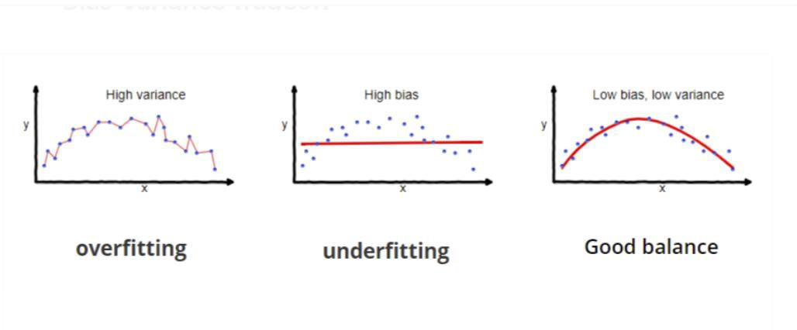
Contents
Variance:
In machine learning, Variance is a type of error that occurs due to a model’s sensitivity to small fluctuations in the dataset. The high variance would cause an algorithm to model the outliers/noise in the training set. This is most commonly referred to as overfitting. In this situation, the model basically learns every data point and does not offer good prediction when it tested on a novel dataset.
Examples of High variance Algorithms include Decision Tree, KNN etc.

Slide 67
Contents
Overfitting vs Underfitting vs Just Right Error in Linear Regression :
Let’s consider a simple regression model that aims to predict a variable Y, from the linear combination of variables X and a normally distributed error term \epsilon
Y = \beta * X + \epsilon
where \epsilon is the normal distribution that adds some noise in the prediction.
Here \beta is the vector representing the coefficient of variables in the X that we need to estimate from the training data. We need to estimate them in such a way that it produces the lowest residual error. This error is defined as:
L_{ols}({\hat{\beta}})= \sum_{i=0}^{n} \left \| y_{i} - x_{i} * \hat{\beta_{i}} \right \|^2 =
\left \| Y - X * \hat{\beta} \right \|^{2}

Slide 68
Contents
To calculate \hat{\beta} we use the following matrix transformation.
\hat{\beta_{ols}} = \left ( X^{T}X \right )^{-1}\left ( X^{T}Y \right )
Here Bias and Variance of \hat{\beta} can be defined as:
Bias(hat{\beta}) = E\left ( \hat{\beta} \right ) - \beta
and
Variance\left ( \hat{\beta} \right ) =\sigma ^{2}\left ( {X}'X \right )^{-1}
We can simplify the error term of the OLS equation defined above in terms of bias and variance as follows:
Error-term = \left ( E\left ( X\hat{\beta} \right ) - X\beta \right )^{2} +E\left ( X\hat{\beta} - E\left ( X\hat{\beta} \right ) \right )^{2}+\sigma^{2}

Slide 69
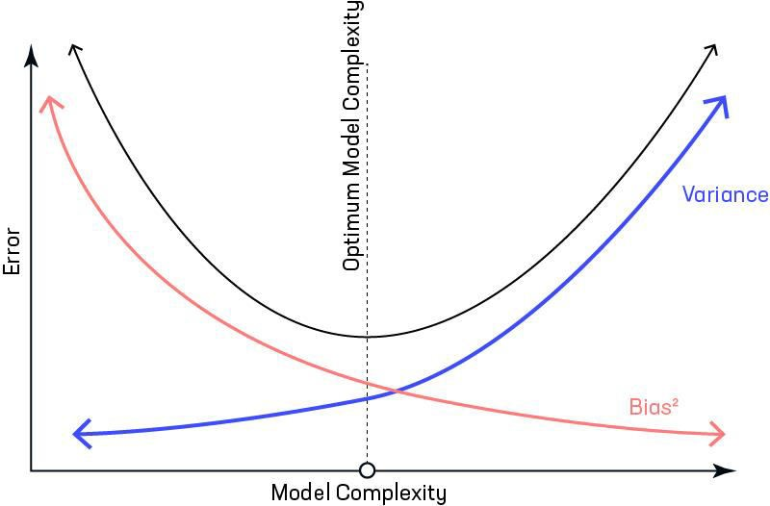
Contents
The first term of above equation represents Bias2. The second term represents Variance and the third term (\sigma^{2}) is unreducible error term.
Variance/ Bias vs Error Variance/ Bias vs Error
Bias vs Variance Tradeoff Variance-Bias-Visualization Variance-Bias-Visualization

Slide 70
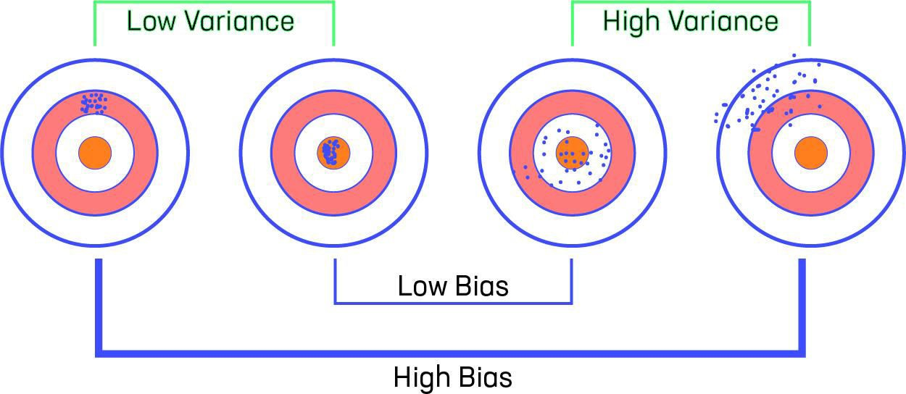
Contents
Let us consider that we have a very accurate model, this model has a low error in predictions and it’s not from the target (which is represented by bull’s eye). This model has low bias and variance. Now, if the predictions are scattered here and there then that is the symbol of high variance, also if the predictions are far from the target then that is the symbol of high bias.
Sometimes we need to choose between low variance and low bias. There is an approach that prefers some bias over high variance, this approach is called Regularization. It works well for most of the classification/regression problems.

Slide 71
Contents
Ridge Regression :
In Ridge regression, we add a penalty term which is equal to the square of the coefficient. The L2 term is equal to the square of the magnitude of the coefficients. We also add a coefficient \lambda to control that penalty term. In this case if \lambda is zero then the equation is the basic OLS else if \lambda \, > \, 0 then it will add a constraint to the coefficient. As we increase the value of \lambda this constraint causes the value of the coefficient to tend towards zero. This leads to tradeoff of higher bias (dependencies on certain coefficients tend to be 0 and on certain coefficients tend to be very large, making the model less flexible) for lower variance.
L_{ridge} = argmin_{\hat{\beta}}\left ({\left \| Y- \beta * X \right \|}^{2} + \lambda *
{\left \| \beta \right \|}_{2}^{2} \right )
where \lambda is regularization penalty.

Slide 72
Contents
Limitation of Ridge Regression: Ridge regression decreases the complexity of a model but does not reduce the number of variables since it never leads to a coefficient been zero rather only minimizes it. Hence, this model is not good for feature reduction.
Lasso Regression :
Lasso regression stands for Least Absolute Shrinkage and Selection Operator. It adds penalty term to the cost function. This term is the absolute sum of the coefficients. As the value of coefficients increases from 0 this term penalizes, cause model, to decrease the value of coefficients in order to reduce loss. The difference between ridge and lasso regression is that it tends to make coefficients to absolute zero as compared to Ridge which never sets the value of coefficient to absolute zero.
L_{lasso} = argmin_{\hat{\beta}}\left ({\left \| Y- \beta * X \right \|}^{2} + \lambda *
{\left \| \beta \right \|}_{1} \right )

Slide 73
Contents
Limitation of Lasso Regression:
Lasso sometimes struggles with some types of data. If the number of predictors (p) is greater than the number of observations (n), Lasso will pick at most n predictors as non- zero, even if all predictors are relevant (or may be used in the test set).
If there are two or more highly collinear variables then LASSO regression select one of them randomly which is not good for the interpretation of data
Elastic Net :
Sometimes, the lasso regression can cause a small bias in the model where the prediction is too dependent upon a particular variable. In these cases, elastic Net is proved to better it combines the regularization of both lasso and Ridge. The advantage of that it does not easily eliminate the high collinearity coefficient.
L_{elasticNet} = argmin_{\hat{\beta}}\left ( \hat\beta \right )\left ( \sum \left ( y - x_i^J\hat{\beta} \right )^2 \right )/2n + \lambda \left ( (1 -\alpha )/2 * \sum_{j=1}^{m}
\hat{\beta_{j}^{2}} + \alpha * \sum_{j=1}^{m} \left \| \hat{\beta_{j}} \right \| \right)

Slide 74
Categorical Variables in Regression
Contents
Objective:
In this topic we learn Categorical regression quantifies which has categorical data ,by assigning numerical values to the categories, resulting in an optimal linear regression equation for the transformed variables. Categorical regression is also known by the acronym CATREG, for categorical regression.
Recap:
Revision of basic statistical approaches.

Slide 75
Contents
5. Categorical Variables in Regression.
Categorical variables (also known as factor or qualitative variables) are variables that classify observations into groups. They have a limited number of different values, called levels. For example the gender of individuals are a categorical variable that can take two levels: Male or Female.
Regression analysis requires numerical variables. So, when a researcher wishes to include a categorical variable in a regression model, supplementary steps are required to make the results interpretable.

Slide 76
Daily Quiz
What do you understand by multiple linear regression?
How does polynomial regression work?
What is the purpose of polynomial regression?
What are the regularization methods?
Explain modify loss function?
What is entropy regularization?
What is elastic net regression?
Define Ridge regression ?
What is Lasso approach?
Define Categorical Variables in Regression?

Slide 77
Weekly/monthly/Unit Wise Assignment.
Assignment
Which of the following is a disadvantage of non-parametric machine learning algorithms?
Which of the following is a true statement for regression methods the in case of feature selection?
In Ridge regression, as the regularization parameter increases, do the regression coefficients decrease?
What is the output of the following?
Is it true that the L1 term in Lasso has the following purposes: performing feature selection, compensating for overfitting, and smoothing?
Which regularization is used to reduce the over fit problem?
To check the linear relationship of dependent and independent continuous variables, which of the following plots are best suited?
The cost function is altered by adding a penalty equivalent to the square of the magnitude of the coefficients
What are the assumptions of linear regression?
Which of the following of the coefficients is added as the penalty term to the loss function in Lasso regression?

Slide 78
Faculty Video Links, You tube & NPTEL Video Links and Online Courses Details
You Tube video
(1) Predictive Analytics Tutorial | Linear Regression in Python | Logistic Regression | Great Learning - YouTube
(2) Multiple Regression Analysis: Hypothesis Tests - YouTube
(3) Mod-06 Lec-28 Goodness of Fit - YouTube

Slide 79
MCQ unit wise/weekly
Question 1: For Ridge Regression, if the regularization parameter = 0, what does it mean?
(A) Large coefficients are not penalized
(B) Overfitting problems are not accounted for
(C) The loss function is as same as the ordinary least square loss function
(D) All of the above
Question 2: For Ridge Regression, if the regularization parameter is very high, which options are true? (Select two)
(A) Large coefficients are significantly penalized
(B) Can lead to a model that is too simple and ends up underfitting the data
(C) Large coefficients are not penalized
(D) Can lead to a model that is too simple and ends up overfitting the data
Question 3: For Lasso Regression, if the regularization parameter = 0, what does it mean? (A) The loss function is as same as the ordinary least square loss function (B) Can be used to select important features of a dataset (C ) Shrinks the coefficients of less important features to exactly 0 (D) All of the above

Slide 80
MCQ unit wise/weekly
Question 4: For Lasso Regression, if the regularization parameter is very high, which options are true? (Select two) (A) Can be used to select important features of a dataset (B) Shrinks the coefficients of less important features to exactly 0 (C) The loss function is as same as the ordinary least square loss function (D) The loss function is as same as the Ridge Regression loss function
Question 5: What’s the penalty term for the Ridge regression? (A) the square of the magnitude of the coefficients (B) the square root of the magnitude of the coefficients (C) the absolute sum of the coefficients (D) the sum of the coefficients

Slide 81
Glossary Questions
1. A scatter diagram is a graph of a linear function.
a. True
b. False
2. In the linear function Y = a + bX, Y is the intercept and X is the slope of the function.
a. True
b. False
3. The slope of a linear function is equal to the change in the dependent variable divided by the corresponding change in the independent variable.
a. True
b. False
4. The Y intercept of a linear function is equal to the value of X when Y is equal to zero.
a. True
b. False
5. If a one unit increase in the value of X results in a two unit decrease in the value of Y, then b = -2.
a. True
b. False
6. If a linear function that is plotted on a graph passes through the origin of a graph, then b = 0.
a. True
b. False

Slide 82
Question Paper Template
 |  | SECTION – A |  | CO
 | Attempt all parts- |  | [10×1=10]
 | 1-a. | Question- | (1)
 | 1-b. | Question- | (1)
 | 1-c. | Question- | (1)
 | 1-d. | Question- | (1)
 | 1-e. | Question- | (1)
 | 1-f. | Question- | (1)
 | 1-g. | Question- | (1)
 | 1-h. | Question- | (1)
 | 1-i. | Question- | (1)
 | 1-j. | Question- | (1)
2. | Attempt all parts- |  | [5×2=10] | CO
 | 2-a. | Question- | (2)
 | 2-b. | Question- | (2)
 | 2-c. | Question- | (2)
 | 2-d. | Question- | (2)
 | 2-e. | Question- | (2)
SECTION – B |  |  |  | CO
3. | Answer any five of the following- |  | [5×6=30]
 | 3-a. | Question- | (6)
 | 3-b. | Question- | (6)
 | 3-c. | Question- | (6)
 | 3-d. | Question- | (6)
 | 3-e. | Question- | (6)
 | 3-f. | Question- | (6)
 | 3-g. | Question- | (6)
SECTION – C |  |  |  | CO
4 | Answer any one of the following- |  | [5×10=50]
 | 4-a. | Question- | (10)
 | 4-b. | Question- | (10)
5. | Answer any one of the following-
 | 5-a. | Question- | (10)
 | 5-b. | Question- | (10)
6. | Answer any one of the following-
 | 6-a. | Question- | (10)
 | 6-b. | Question- | (10)
7. | Answer any one of the following-
 | 7-a. | Question- | (10)
 | 7-b. | Question- | (10)
8. | Answer any one of the following-
 | 8-a. | Question- | (10)
 | 8-b. | Question- | (10)

Slide 83

Semester Paper

Slide 84
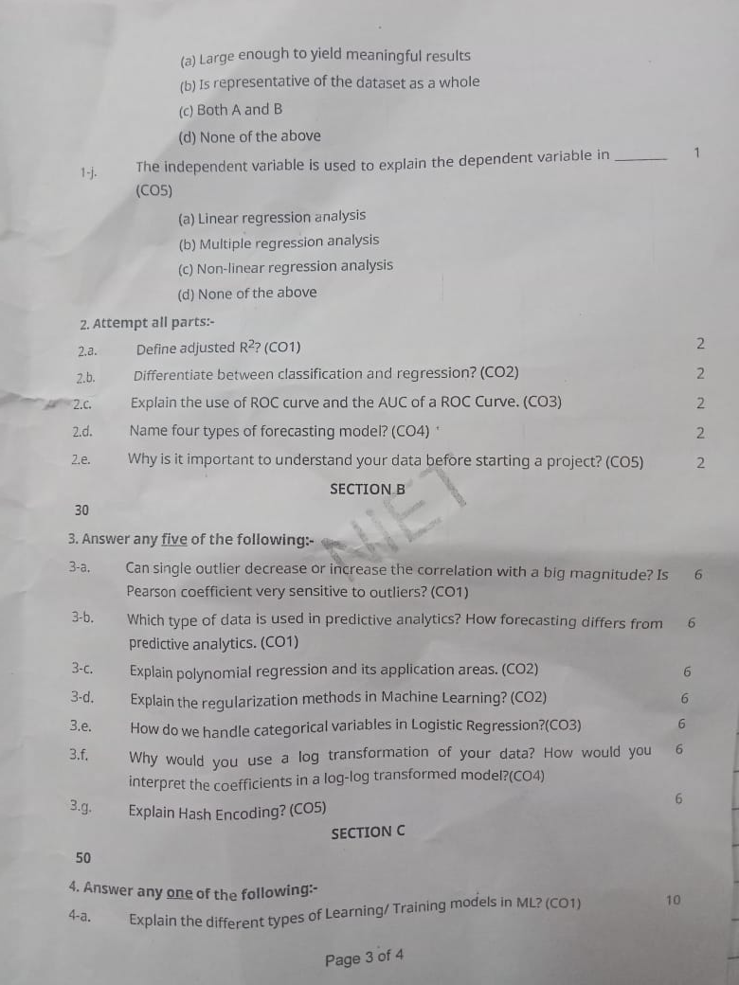
Semester Paper

Slide 85
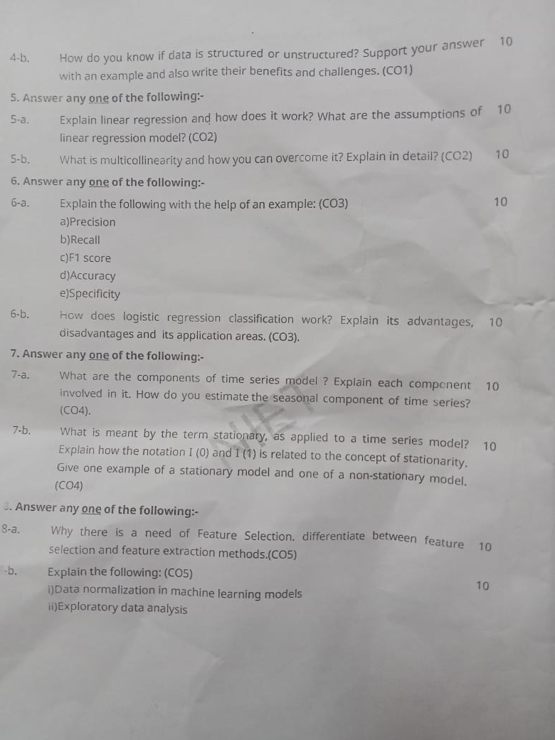
Semester Paper

Slide 86
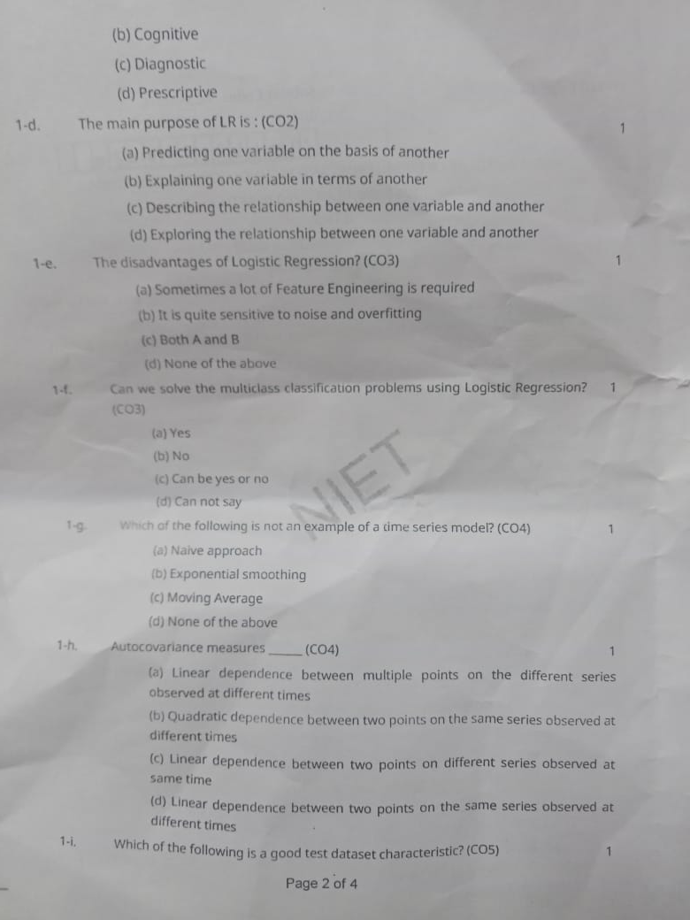
Semester Paper

Slide 87
Expected Questions for University Exam
What type of penalty is used on regression weights in Ridge regression?
If two variables, x and y, have a very strong linear relationship, then
Which of the following is used for evaluating regression models?
Lasso Regression uses which norm?
Ridge Regression uses which norm?
In Ridge regression, A hyper parameter is used called “________” that controls the weighting of the penalty to the loss function.
The scikit-learn Python machine learning library provides an implementation of the Ridge Regression algorithm via the Ridge class.Confusingly, the lambda term can be configured via the “________” argument when defining the class.
Ridge regression can reduce the slope close to zero (but not exactly zero) but Lasso regression can reduce the slope to be exactly equal to zero.
Ridge regression takes _________ value of variables.
Ridge regression takes _________ value of variables.

Slide 88
References
Text books
1. Dean Abbott ,“Applied Predictive Analytics Principles and Techniques for the Professional DataAnalyst” , Wiley.
2. “Fundamentals of Machine Learning for Predictive Data Analytics” By John D. Kelleher, Brian Mac Namee and Aoife D'Arcy
3. Predictive & Advanced Analytics (IBM ICE Publication)
Reference Books
1. “An Introduction to Statistical Learning: with Applications in R” by James, Witten, Hastie and Tibshirani, Springer, 1st. Edition, 2013.
2.“R for Everyone: Advanced Analytics and Graphics” by Lander, J., Addison-Wesley Data & Analytics Series, 1 edition, 2013.
3.Sandeep Rakshit, R for Beginners, McGraw Hill (2017).

Slide 89
Recap
This unit provide us fundamentals domain of predictive analytics and its latest trends in industry as per data standards.
In this unit we are also benefitted with the knowledge of different types of data and very important is the implementation of machine learning and also through the concept model building which is used in industry prospects.
This unit will impart us with knowledge of business analytics and tolls used in data science.

Slide 90
Contents
Thank You

